Slide 1
COVID-19 in Africa
Econ 2509, Fall ‘21
Group 10: Sejoon P., Sneha B., Tyler W

Slide 2
Table of Contents
Abstract
Hypothesis
Data
Exploratory Analysis
Descriptive Statistics
Plot 1: COVID Deaths Histogram
Plot 2: COVID Deaths vs age65 Regression
Regression Analysis
Baseline Regression
Alternative Regression
Hypothesis Tests
Data Shortcomings
Conclusion

Slide 3
I. Abstract
COVID-19 has spread worldwide with more than 260M cases reported, resulting in 5.2M deaths. COVID has impacted the world’s most developed economies by stifling trade, travel, GDP, and a host of other economic indicators. Africa is the world’s poorest continent as defined by people living in poverty, and therefore includes a population that is vulnerable to the spread of infectious disease. Africa is also the continent with the least amount of vaccinated individuals. Therefore, we collected and analyzed data on COVID-19 deaths for each country in Africa, and have chosen variables we believe to be indicators in driving deaths.

Slide 4
II. Hypothesis
COVID-19 deaths are likely to be higher in more populated, less developed countries.
Less developed: We use this term to mean a country with a less robust economy as it relates to education, development indicators (AIDI), lower healthcare costs per capita, and a country with a low political stability score.

Slide 5
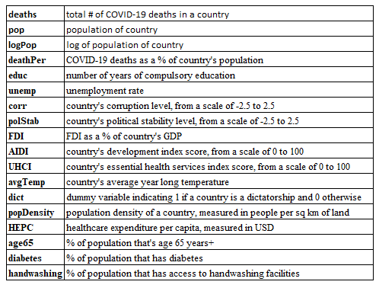
III. Data
Original dataset from Kaggle
Country, total cases, total deaths, total recovered, total population
Compiled from respective government websites
Added data from the World Bank
2019 data, or most recent available
Self-calculated fields
logPop
deathPer
Dummy variable
Dict
Variable of interest: deaths
Notes:
Original dataset from Kaggle
Country, total cases, total deaths, total recovered, total population
Compiled from various government websites
Added data from The World Bank databank

Slide 6
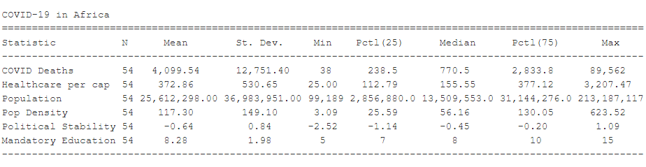
IV. Exploratory Analysis: Descriptive Statistics
There are 54 countries included in the dataset, which includes all countries in Africa
The average healthcare spend per capita is $372.86 USD, compared to ~$10,600 in the USA
The average years of compulsory schooling is 8 with a standard deviation of ~2 years.
The average population size is 25.612M.
Political stability is relatively low on the continent, sitting at -.64 on a scale from -2.5 to 2.5, with 2.5 being the most political stable a country can be.
The average population density is 117 people per square mile; for context, the USA has a population density of ~93 people per square mile
South Africa has, by far, the most deaths at 89,562 while Burundi has the least at 38
Notes:
Talk about skewness of data, and how we know deaths are not normally distributed

Slide 7
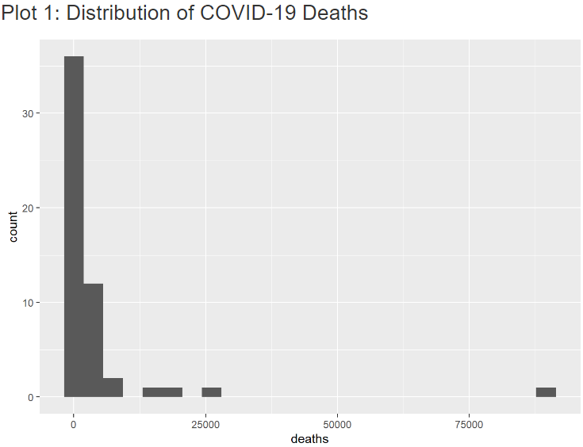
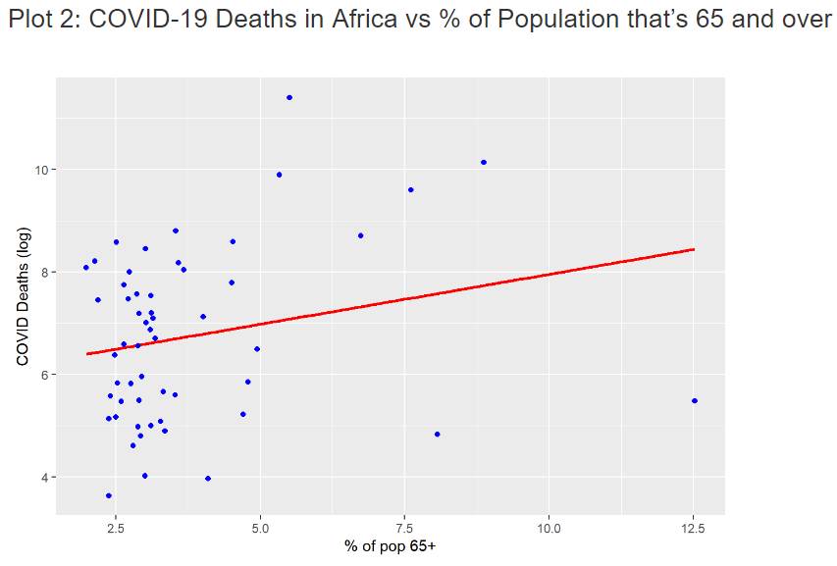
IV. Exploratory Analysis: Plots
Confirms distribution of deaths is not normal, so we will transform using log of deaths
Older countries face more COVID deaths

Slide 8
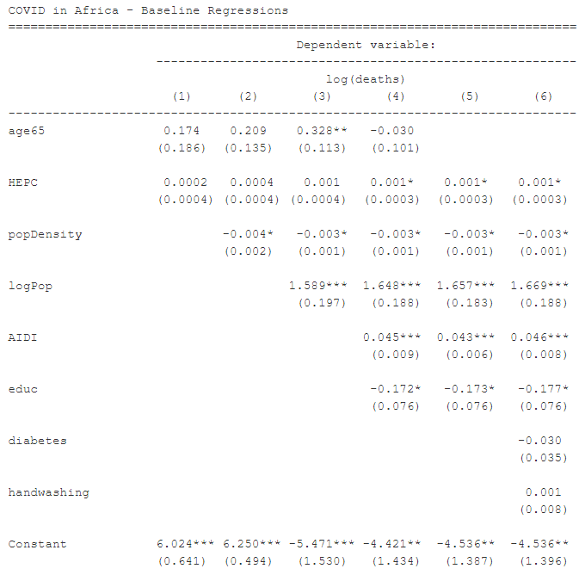
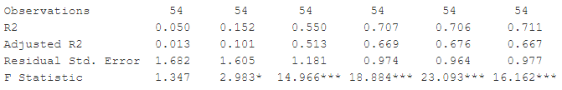
V. Regression Analysis: Baseline
A country with 1USD higher HEPC, would have 0.1% more COVID deaths on average.
A country with 1 person per sq mile more, would have 0.3% lesser COVID deaths on average.
If a country's population increases by 1% , it would have 1.657% more COVID deaths on average.
A country with a 1 point higher AIDI score, would have 4.3% more COVID deaths on average.
If a country's mandatory schooling is increased by 1 year , it would have 17.3% lesser COVID deaths on average.
All estimates are statistically significant and the magnitude of the effects is economically significant.
HEPC, population density, log of population, AIDI, and education explain 67.6% of the variation in log deaths.

Slide 9
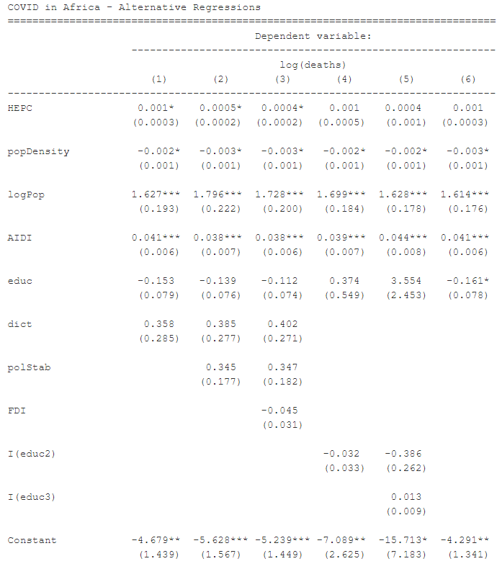
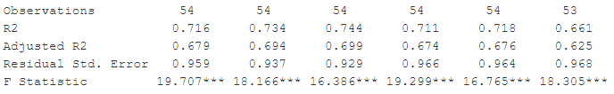
V. Regression Analysis: Alternative
In the alt regression, we included dictatorship (dummy), political stability and FDI which we thought may contribute to COVID-19 deaths.
Adjusted R2 increased, but these variables are not statistically significant and also decreased the estimator’s coefficient.
The baseline shows significant effect to R2 when we add education, so we added square and cube variations of this estimator, which indicated a rise in adjusted R2 but not much change in the coefficients.

Slide 10
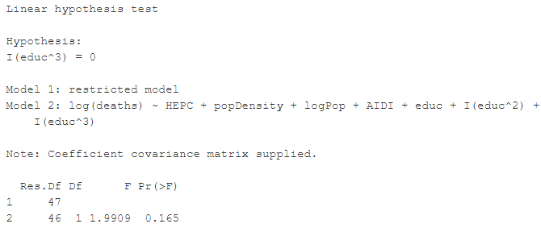
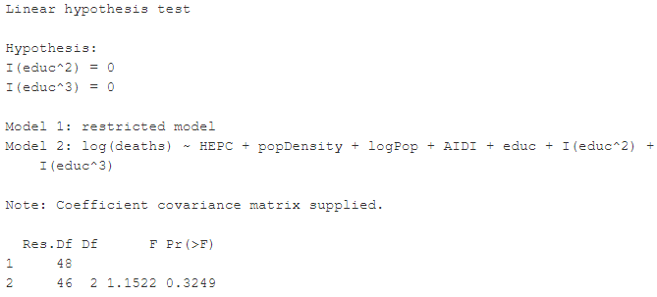
V. Regression Analysis: Hypothesis Tests
Based on these F-tests, we can conclude that the linear specification is preferred to the quadratic and cubic ones.

Slide 11
VI. Data Limitations
Limitations on recordkeeping and availability of data in developing countries, especially ones with large rural populations.
South Africa is an outlier - it has more than triple the amount of deaths than the country with the second highest COVID-19 deaths.
Our variables don’t cover the same period of time - COVID-19 deaths is the total # of deaths since the beginning of the pandemic until current day, while most of our variables cover the entirety of 2019 (or most recent data available).
8 countries did not have data for % of population that has handwashing facilities available to them.
Notes:
South Africa is an outlier - it has more than triple the amount of deaths than the country with the second highest COVID-19 deaths
Limitations on recordkeeping and availability of data in developing countries, especially ones with large rural populations
Our variables don’t cover the same period of time - COVID-19 deaths is the total # of deaths since the beginning of the pandemic until current day, while most of our variables cover the entirety of 2019 (or most recent data available)
8 countries did not have data for % of population that has handwashing facilities available to them

Slide 12
VII. Conclusion
Healthcare expenditure, population, Africa infrastructure development index have positive effect on COVID deaths.
Population density and education have negative causal effect on COVID deaths in Africa.
A country's percentage of population that's over 65 years of age or has diabetes or has access to handwashing facilities does not seem to have a causal effect on COVID deaths in Africa, which is contradictory to what has been indicated by general science, which might be due to under counting of COVID-19 deaths by country.

